Slide 1

Project Background and Problem Statement
Mechanical hands have existed for years
Inaccurate motions
Poor ability to grasp irregularly shaped objects

Slide 2

Societal Impact
Prosthetic
Manufacturing and automation
Handling of dangerous materials
Open source

Slide 3
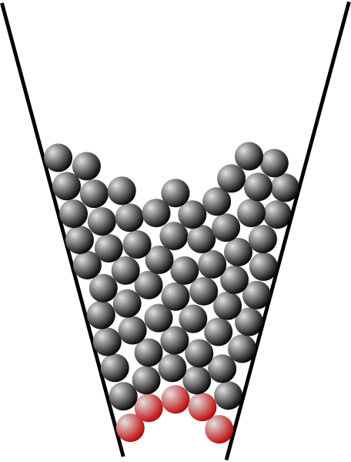
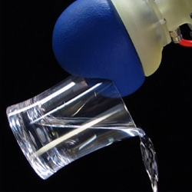
Features of Design – Granular Jamming
Jamming –a physical process by which some materials, such as granular materials become rigid with increasing density.
Notes:
When particles are not jammed, they are able to flow past each other. When jammed, the group of particles becomes more rigid, like how sand can be poured, but is still able to support your weight when you stand on it.
The planned design will make use of this by having pads of granular material along the palm of the hand, and then forcing the granules to jam by sucking the air out of the sac.

Slide 4
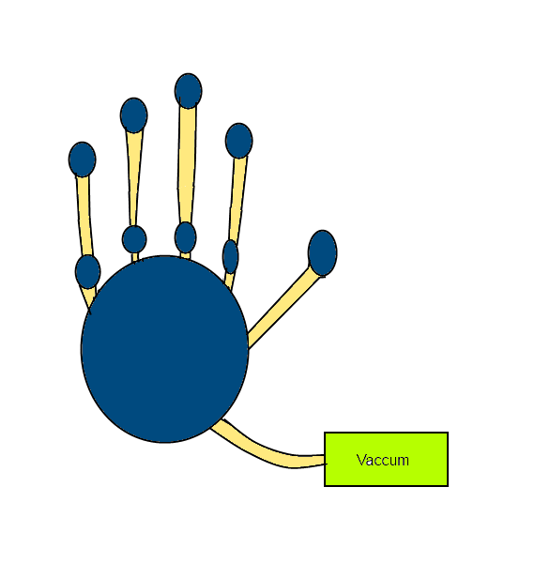
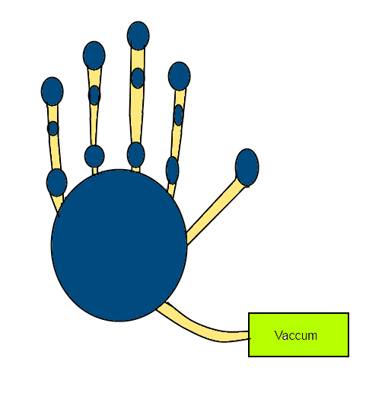
Conceptual Design Comparison
Layout of Granular Jamming Pads
Pad in each length
Pad in first and third length

Slide 5
Conceptual Design Comparison
Connecting jamming pads to vacuum
Each pad has a tube to the vacuum
Pads have connections to each other

